Slide 1
Developing Servlets for Backend

Slide 2
Develop Servlets for the Admin Backend to Perform CRUD Operations with HTTP Request Response

Slide 3
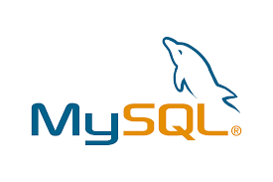




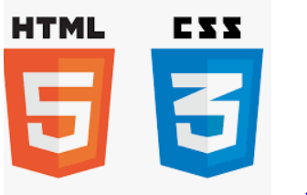

Before we begin, let's recall what we have covered till now:
Agile
Git
SQL
Angular
HTML
CSS
JavaScript
CoreJava

Slide 4





Before we begin, let's recall what we have covered till now:
JDBC
JSP
Servlets
MongoDB
Maven

Slide 5


Before we begin, let's recall what we have covered till now:
JUnit
Spring

Slide 6
Maven Project for Backend
Created a Maven project with an archetype as a web app in Eclipse EE
Created packages for admin and end user modules
Developed various POJO Classes
Developed DAO for CRUD Operations
Created various classes for the admin and end user that follow the DAO design pattern for CRUD operations
Decoupled the model from the Database Persistence layer
MySQL Connectivity
Configured MySQL, servlet, JSP, and Tomcat dependencies
Executed JDBC code with DAO design pattern for DB CRUD operations
Build and Execute
Built and executed the Maven web app project and packed the web project as a war file

Slide 7
As a full stack web developer, our key role is to develop both client and server software.
Angular and Node can be used to build front end of the web page.
Spring Boot, Java and MySQL or MongoDB can be used to build at the back end.

Slide 8

Bob needs to develop the design Pattern DAO in a generic manner. So, Bob brainstorms a bit and finds a solution.
Let me use Java, OOPS, and JDBC to develop the design Pattern DAO in a generic manner.
In this lesson, we will implement CRUD Operations with JDBC for our various models using Servlets for HTTP Request Response and help Bob to complete his task effectively and quickly.

Slide 9

Implement Servlets for HTTP Request Response
Connect with MySQL using JDBC and DAO Classes in Servlets
Create CRUD Operations for the Admin and End User in Servlet Request
Send JSON Response for the Request from Servlet

Slide 10
Develop Servlets Classes for Admin Backend

Slide 11
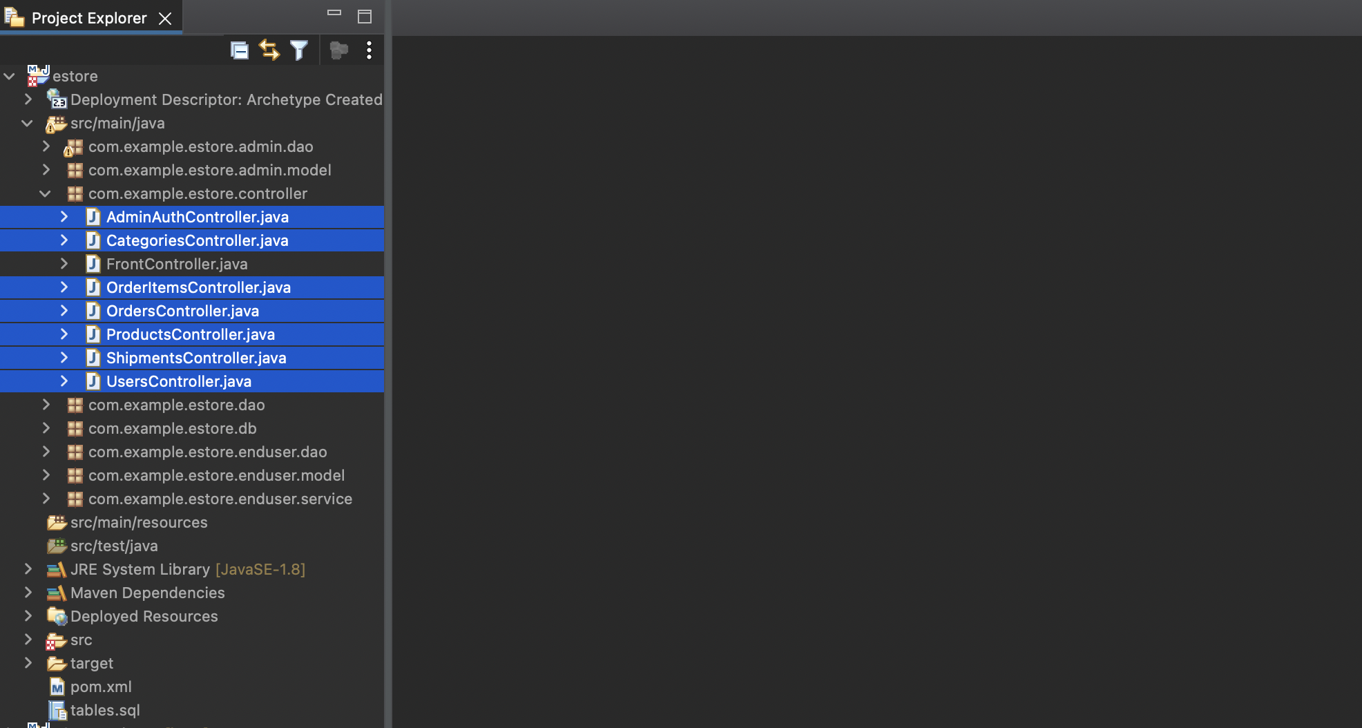
Create Servlets as Controllers Implementing DAO for Admin
Create various servlets as controllers, which will process requests and responses, using DAO to perform CRUD operations for the backend admin.
Notes:
Now we will create various Servlets as controller which will process request and response using DAO to perform CRUD Operations for Admin Backend

Slide 12
Create Servlets as Controllers Implementing DAO for Admin
UsersController.java: Servlet for HTTP Request Response for users, which will manage CRUD operations using DAO
Notes:
Overview of Servlets as Controller which will be used:
UsersController.java
Servlet for HTTP Request Response for User which will manage CRUD Operations using DAO

Slide 13
Create Servlets as Controllers Implementing DAO for Admin
CategoriesController.java: Servlet for HTTP Request Response for product categories, which will manage CRUD operations using DAO
Notes:
CategoriesController.java
Servlet for HTTP Request Response for Product Categories, which will manage CRUD Operations using DAO

Slide 14
Create Servlets as Controllers Implementing DAO for Admin
OrdersController.java: Servlet for HTTP Request Response for orders placed by users, which will manage CRUD operations using DAO
Notes:
OrdersController.java
Servlet for HTTP Request Response for Orders placed by Users, which will manage CRUD Operations using DAO

Slide 15
Create Servlets as Controllers Implementing DAO for Admin
OrderItemsController.java: Servlet for HTTP Request Response for items in an order, which will manage CRUD operations using DAO
Notes:
OrderItemsController.java
Servlet for HTTP Request Response for items in an order, which will manage CRUD Operations using DAO

Slide 16
Create Servlets as Controllers Implementing DAO for Admin
ProductsController.java: Servlet for HTTP Request Response for products in the estore, which will manage CRUD operations using DAO
Notes:
ProductsController.java
Servlet for HTTP Request Response for Products in the estore, which will manage CRUD Operations using DAO

Slide 17
Create Servlets as Controllers Implementing DAO for Admin
ShipmentsController.java: Servlet for HTTP Request Response for shipments of orders placed by users, which will manage CRUD operations using DAO
Notes:
ShipmentsController.java
Servlet for HTTP Request Response for shipments of the orders placed by Users, which will manage CRUD Operations using DAO

Slide 18
Create Response Model: Response.java
Perform HTTP Request and Response for servlets. For every request, share the data to the client as a response.
public class Response<T> {
Integer code;
String message;
List<T> data;
public Response() {
// TODO Auto-generated constructor stub
}
Create response model with attributes like response code, message and some data.
Notes:
For the Servlets, we need to perform HTTP Request and Response. For every request we will share the data to the client as a response. For which we need to create a response model with attributes like response code, message and may be some data

Slide 19
Create Response Model: Response.java
The Response object shall be sent back as a JSON to the client by servlets as a response.
public Response(Integer code, String message, List<T> data) {
this.code = code;
this.message = message;
this.data = data;
}
//….
}
Contains code, message and an optional data list if request is to get data
Notes:
Response Object shall be sent back as a JSON to the client by servlets as a response.
It contains code, message and an optional data list if request is to get data.

Slide 20
Add GSON Dependency to Send the JSON Response to the Client
In a Maven project, open the pom.xml file and add the dependency for Google GSON Library.
Find it on mvnrepository.com.
<dependency>
<groupId>com.google.code.gson</groupId>
<artifactId>gson</artifactId>
<version>2.9.0</version>
</dependency>
Notes:
In your maven project, open the pom.xml file and add the dependency for google GSON Library. You can find it on mvnrepository.com

Slide 21
Add GSON Dependency to Send the JSON Response to the Client
The library uses GSON objects to convert the Java object into JSON.
String jsonResponse = new Gson().toJson(object);
The library uses GSON Object’s toJson method to convert the Java object into JSON.
Notes:
The library uses GSON Object’s toJson method to convert the Java Object into JSON

Slide 22
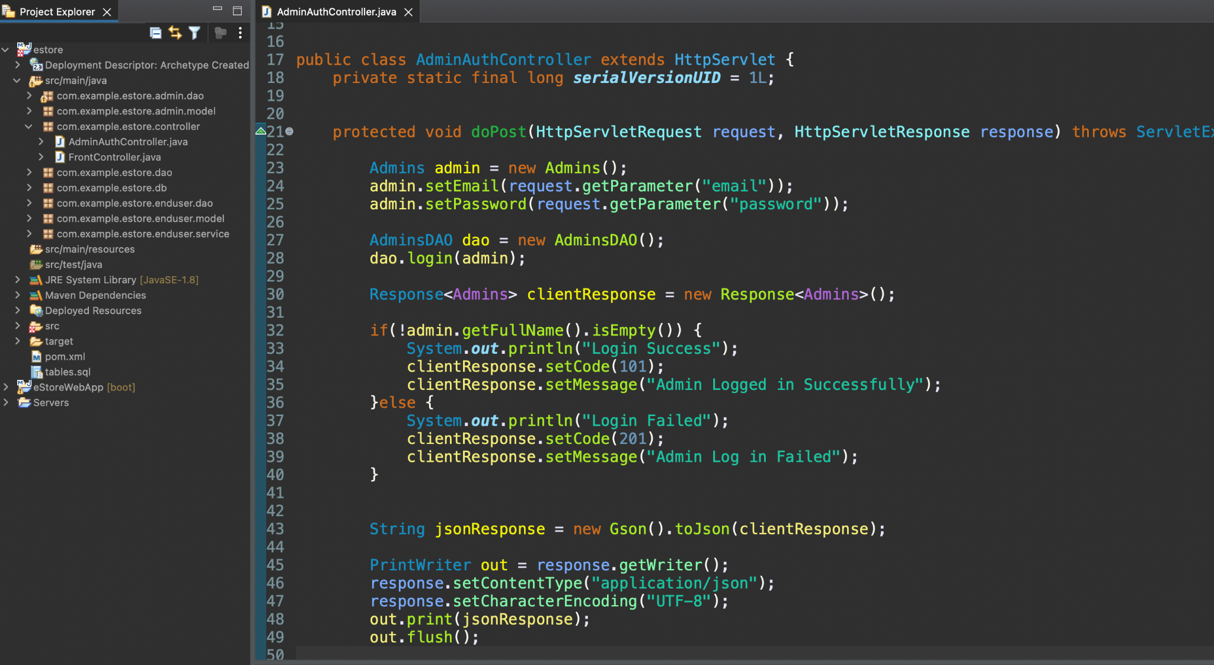
AdminAuthController.java
Create a servlet to authenticate the admin for logging into the Angular dashboard.
Notes:
Now, let us create Servlet to Authenticate the Admin for Logging into the Angular Dashboard.

Slide 23
AdminAuthController.java
Override the doPost method.
Capture the request data from client into Admin Object.
Notes:
Override the doPost method and capture the request data from the client into the Admin Object.

Slide 24
AdminAuthController.java
If the user login is successful, get the details of the admin in the object.
Pass admin object into the Admin DAO to authenticate user using login method.
Check the name of the admin to be a non-empty string.
Notes:
Than pass the admin object into the Admin DAO to authenticate the user using the login method. If the user login is successful, we will get the details of the admin in the object.
Check the Name of the Admin to be a non empty string and hence, login is successful.

Slide 25
AdminAuthController.java
Send the JSON Response back to the client using Google GSON.
Notes:
Send the JSON Response back to the client accordingly using Google GSON.

Slide 26
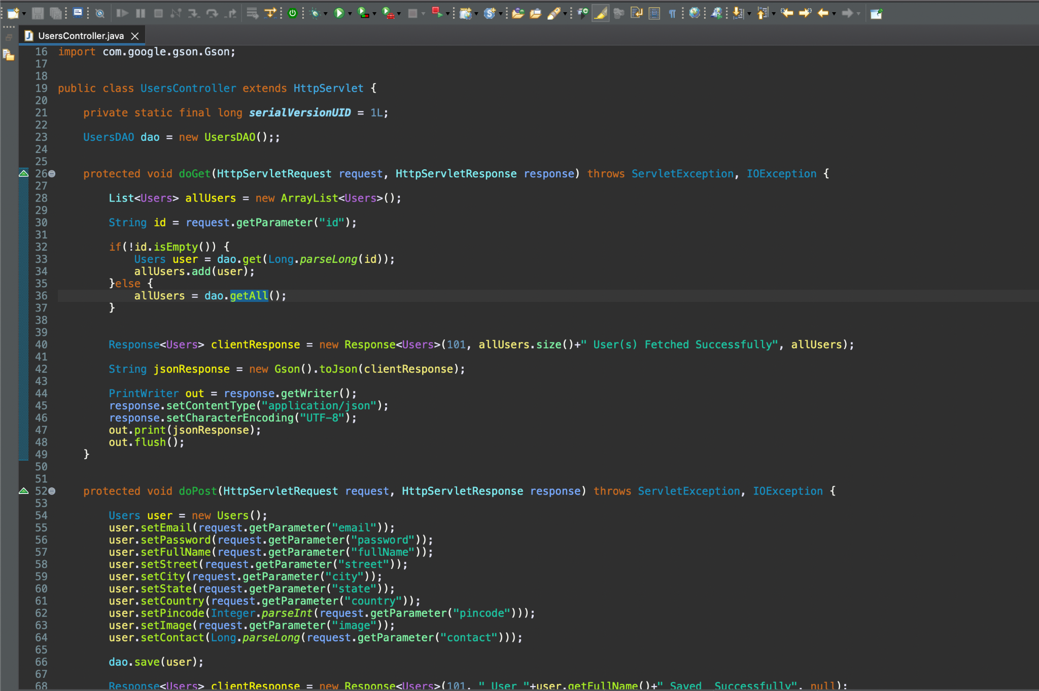
UsersController.java: Implementation of Servlet for Users
To perform CRUD Operations for the users, use user’s table and user’s model, UsersDAO with DB operations is implemented already.
Notes:
In order to perform CRUD Operations for the User and details of the User we got Users Table and Users Model, UsersDAO with DB operations,implemented already.

Slide 27
UsersController.java: Implementation of Servlet for Users
doGet, doPost, doPut, doDelete methods are implemented in servlets to perform CRUD operations using DAO and Models internally.
Notes:
We will implement doGet, doPost, doPut, doDelete methods in our Servlet to perform CRUD operations using DAO and Models internally to:

Slide 28
UsersController.java: Implementation of Servlet for Users
doGet - Gets a single user based on user id or a list of user objects
public class UsersController extends HttpServlet {
private static final long serialVersionUID = 1L;
UsersDAO dao = new UsersDAO();;
protected void doGet(HttpServletRequest request, HttpServletResponse response) throws ServletException, IOException {
List<Users> allUsers = new ArrayList<Users>();
String id = request.getParameter("id");
if(!id.isEmpty()) {
Users user = dao.get(Long.parseLong(id));
allUsers.add(user);
}else {
allUsers = dao.getAll();
}
Notes:
doGet - get a single User based on user id or a list of User objects i.e. fetch all the users
public class UsersController extends HttpServlet {
private static final long serialVersionUID = 1L;
UsersDAO dao = new UsersDAO();;
protected void doGet(HttpServletRequest request, HttpServletResponse response) throws ServletException, IOException {
List<Users> allUsers = new ArrayList<Users>();
String id = request.getParameter("id");
if(!id.isEmpty()) {
Users user = dao.get(Long.parseLong(id));
allUsers.add(user);
}else {
allUsers = dao.getAll();
}

Slide 29
UsersController.java: Implementation of Servlet for Users
Response<Users> clientResponse = new Response<Users>(101, allUsers.size()+" User(s) Fetched Successfully", allUsers);
String jsonResponse = new Gson().toJson(clientResponse);
PrintWriter out = response.getWriter();
response.setContentType("application/json");
response.setCharacterEncoding("UTF-8");
out.print(jsonResponse);
out.flush();
}
Notes:
Response<Users> clientResponse = new Response<Users>(101, allUsers.size()+" User(s) Fetched Successfully", allUsers);
String jsonResponse = new Gson().toJson(clientResponse);
PrintWriter out = response.getWriter();
response.setContentType("application/json");
response.setCharacterEncoding("UTF-8");
out.print(jsonResponse);
out.flush();
}

Slide 30
UsersController.java: Implementation of Servlet for Users
doPost - Adds a new user in the database by taking the details of user in HttpRequest and sending HttpResponse as JSON for success or failure cases
protected void doPost(HttpServletRequest request, HttpServletResponse response) throws ServletException, IOException {
Users user = new Users();
user.setEmail(request.getParameter("email"));
user.setPassword(request.getParameter("password"));
user.setFullName(request.getParameter("fullName"));
user.setStreet(request.getParameter("street"));
user.setCity(request.getParameter("city"));
user.setState(request.getParameter("state"));
user.setCountry(request.getParameter("country"));
user.setPincode(Integer.parseInt(request.getParameter("pincode")));
user.setImage(request.getParameter("image"));
user.setContact(Long.parseLong(request.getParameter("contact")));
dao.save(user);
Notes:
doPost - Add a new User in the database by taking the details of User in HttpRequest and sending HttpResponse as JSON for success/failure cases
protected void doPost(HttpServletRequest request, HttpServletResponse response) throws ServletException, IOException {
Users user = new Users();
user.setEmail(request.getParameter("email"));
user.setPassword(request.getParameter("password"));
user.setFullName(request.getParameter("fullName"));
user.setStreet(request.getParameter("street"));
user.setCity(request.getParameter("city"));
user.setState(request.getParameter("state"));
user.setCountry(request.getParameter("country"));
user.setPincode(Integer.parseInt(request.getParameter("pincode")));
user.setImage(request.getParameter("image"));
user.setContact(Long.parseLong(request.getParameter("contact")));
dao.save(user);

Slide 31
UsersController.java: Implementation of Servlet for Users
Response<Users> clientResponse = new Response<Users>(101, " User "+user.getFullName()+" Saved Successfully", null);
String jsonResponse = new Gson().toJson(clientResponse);
PrintWriter out = response.getWriter();
response.setContentType("application/json");
response.setCharacterEncoding("UTF-8");
out.print(jsonResponse);
out.flush();
}
Notes:
Response<Users> clientResponse = new Response<Users>(101, " User "+user.getFullName()+" Saved Successfully", null);
String jsonResponse = new Gson().toJson(clientResponse);
PrintWriter out = response.getWriter();
response.setContentType("application/json");
response.setCharacterEncoding("UTF-8");
out.print(jsonResponse);
out.flush();
}

Slide 32
UsersController.java: Implementation of Servlet for Users
doPut - Updates an existing user in the database by taking the details of user in HttpRequest and sending HttpResponse as JSON for success or failure cases
@Override
protected void doPut(HttpServletRequest request, HttpServletResponse response) throws ServletException, IOException {
Users user = new Users();
user.setUserId(Integer.parseInt(request.getParameter("userId")));
user.setEmail(request.getParameter("email"));
user.setPassword(request.getParameter("password"));
user.setFullName(request.getParameter("fullName"));
user.setStreet(request.getParameter("street"));
user.setCity(request.getParameter("city"));
user.setState(request.getParameter("state"));
user.setCountry(request.getParameter("country"));
user.setPincode(Integer.parseInt(request.getParameter("pincode")));
user.setImage(request.getParameter("image"));
user.setContact(Long.parseLong(request.getParameter("contact")));
dao.update(user);
Notes:
doPut - Update an existing User in the database by taking the details of User in HttpRequest and sending HttpResponse as JSON for success/failure cases
@Override
protected void doPut(HttpServletRequest request, HttpServletResponse response) throws ServletException, IOException {
Users user = new Users();
user.setUserId(Integer.parseInt(request.getParameter("userId")));
user.setEmail(request.getParameter("email"));
user.setPassword(request.getParameter("password"));
user.setFullName(request.getParameter("fullName"));
user.setStreet(request.getParameter("street"));
user.setCity(request.getParameter("city"));
user.setState(request.getParameter("state"));
user.setCountry(request.getParameter("country"));
user.setPincode(Integer.parseInt(request.getParameter("pincode")));
user.setImage(request.getParameter("image"));
user.setContact(Long.parseLong(request.getParameter("contact")));
dao.update(user);

Slide 33
UsersController.java: Implementation of Servlet for Users
Response<Users> clientResponse = new Response<Users>(101, " User "+user.getFullName()+" Updated Successfully", null);
String jsonResponse = new Gson().toJson(clientResponse);
PrintWriter out = response.getWriter();
response.setContentType("application/json");
response.setCharacterEncoding("UTF-8");
out.print(jsonResponse);
out.flush();
}
Notes:
Response<Users> clientResponse = new Response<Users>(101, " User "+user.getFullName()+" Updated Successfully", null);
String jsonResponse = new Gson().toJson(clientResponse);
PrintWriter out = response.getWriter();
response.setContentType("application/json");
response.setCharacterEncoding("UTF-8");
out.print(jsonResponse);
out.flush();
}

Slide 34
UsersController.java: Implementation of Servlet for Users
doDelete - Deletes an existing user in the database by taking the user id of user in HttpRequest and sending HttpResponse as JSON for success or failure cases
@Override
protected void doDelete(HttpServletRequest request, HttpServletResponse response) throws ServletException, IOException {
String userId = request.getParameter("userId");
dao.delete(Integer.parseInt(userId));
Response<Users> clientResponse = new Response<Users>(101, " User with Id "+userId+" Deleted Successfully", null);
Notes:
doDelete - Delete an existing User in the database by taking the user id of User in HttpRequest and sending HttpResponse as JSON for success/failure cases
@Override
protected void doDelete(HttpServletRequest request, HttpServletResponse response) throws ServletException, IOException {
String userId = request.getParameter("userId");
dao.delete(Integer.parseInt(userId));
Response<Users> clientResponse = new Response<Users>(101, " User with Id "+userId+" Deleted Successfully", null);

Slide 35
UsersController.java: Implementation of Servlet for Users
String jsonResponse = new Gson().toJson(clientResponse);
PrintWriter out = response.getWriter();
response.setContentType("application/json");
response.setCharacterEncoding("UTF-8");
out.print(jsonResponse);
out.flush();
}
}
Notes:
String jsonResponse = new Gson().toJson(clientResponse);
PrintWriter out = response.getWriter();
response.setContentType("application/json");
response.setCharacterEncoding("UTF-8");
out.print(jsonResponse);
out.flush();
}
}

Slide 36
CategoriesController.java: Implementation of Servlet for Product Categories
To perform CRUD operations for the categories, use get categories table and categories model, categoriesdao with DB operations is implemented already.
package com.example.estore.controller;
import java.io.IOException;
import javax.servlet.ServletException;
import javax.servlet.http.HttpServlet;
import javax.servlet.http.HttpServletRequest;
import javax.servlet.http.HttpServletResponse;
public class CategoriesController extends HttpServlet {
private static final long serialVersionUID = 1L;
Notes:
Likewise you need to now implement other servlets.
Let us now implement CategoriesController Servlet.
In order to perform CRUD Operations for the Categories and details of the Categories we got Categories Table and Categories Model, CategoriesDAO with DB operations, implemented already

Slide 37
CategoriesController.java: Implementation of Servlet for Product Categories
doGet – Gets a single Product Category based on category ID or a list of Category objects
protected void doGet(HttpServletRequest request, HttpServletResponse response) throws ServletException, IOException {
// TODO Auto-generated method stub
}
Notes:
We will implement doGet, doPost, doPut, doDelete methods in our Servlet to perform CRUD operations using DAO and Models internally to:
doGet - get a single Product Category based on category id or a list of Category objects i.e. fetch all the categories

Slide 38
CategoriesController.java: Implementation of Servlet for Product Categories
doPost - Adds a new Category in the database by taking the details of Product Category in HttpRequest and sending HttpResponse as JSON for success or failure cases
protected void doPost(HttpServletRequest request, HttpServletResponse response) throws ServletException, IOException {
// TODO Auto-generated method stub
}
Notes:
doPost - Add a new Category in the database by taking the details of Product Category in HttpRequest and sending HttpResponse as JSON for success/failure cases

Slide 39
CategoriesController.java: Implementation of Servlet for Product Categories
doPut - Updates an existing Category in the database by taking the details of Product Category in HttpRequest and sending HttpResponse as JSON for success or failure cases
protected void doPut(HttpServletRequest request, HttpServletResponse response) throws ServletException, IOException {
// TODO Auto-generated method stub
}
Notes:
doPut - Update an existing Category in the database by taking the details of Product Category in HttpRequest and sending HttpResponse as JSON for success/failure cases

Slide 40
CategoriesController.java: Implementation of Servlet for Product Categories
doDelete - Deletes an existing Category in the database by taking the category id of Product Category in HttpRequest and sending HttpResponse as JSON for success or failure cases
protected void doDelete(HttpServletRequest request, HttpServletResponse response) throws ServletException, IOException {
// TODO Auto-generated method stub
}
}
Notes:
doDelete - Delete an existing Category in the database by taking the category id of Product Category in HttpRequest and sending HttpResponse as JSON for success/failure cases

Slide 41
ProductsController.java: Implementation of Servlet for Products
To perform CRUD Operations for the product, use Products Table and Products Model, ProductsDAO with DB operations implemented already.
package com.example.estore.controller;
import java.io.IOException;
import javax.servlet.ServletException;
import javax.servlet.http.HttpServlet;
import javax.servlet.http.HttpServletRequest;
import javax.servlet.http.HttpServletResponse;
public class ProductsController extends HttpServlet {
private static final long serialVersionUID = 1L;
Notes:
Let us now implement ProductsController Servlet.
In order to perform CRUD Operations for the Products and details of the Products we got Products Table and Products Model, ProductsDAO with DB operations, implemented already

Slide 42
ProductsController.java: Implementation of Servlet for Products
doGet - gets a single Product based on product id or a list of Product objects, that is fetches all the products.
protected void doGet(HttpServletRequest request, HttpServletResponse response) throws ServletException, IOException {
// TODO Auto-generated method stub
}
Notes:
We will implement doGet, doPost, doPut, doDelete methods in our Servlet to perform CRUD operations using DAO and Models internally to:
doGet - get a single Product based on product id or a list of Product objects i.e. fetch all the products

Slide 43
ProductsController.java: Implementation of Servlet for Products
doPost - Adds a new Product in the database by taking the details of Product in HttpRequest and sending HttpResponse as JSON for success or failure cases
protected void doPost(HttpServletRequest request, HttpServletResponse response) throws ServletException, IOException {
// TODO Auto-generated method stub
}
Notes:
doPost - Add a new Product in the database by taking the details of Product in HttpRequest and sending HttpResponse as JSON for success/failure cases

Slide 44
ProductsController.java: Implementation of Servlet for Products
doPut - Updates an existing Product in the database by taking the details of Product in HttpRequest and sending HttpResponse as JSON for success or failure cases
protected void doPut(HttpServletRequest request, HttpServletResponse response) throws ServletException, IOException {
// TODO Auto-generated method stub
}
Notes:
doPut - Update an existing Product in the database by taking the details of Product in HttpRequest and sending HttpResponse as JSON for success/failure cases

Slide 45
ProductsController.java: Implementation of Servlet for Products
doDelete - Deletes an existing Product in the database by taking the Product ID of Product in HttpRequest and sending HttpResponse as JSON for success or failure cases.
protected void doDelete(HttpServletRequest request, HttpServletResponse response) throws ServletException, IOException {
// TODO Auto-generated method stub
}
}
Notes:
doDelete - Delete an existing Product in the database by taking the Product id of Product in HttpRequest and sending HttpResponse as JSON for success/failure cases

Slide 46
OrdersController.java: Implementation of Servlet for Orders
To perform CRUD operations for the orders, use get orders table and orders model, ordersdao with DB operations, implemented already.
package com.example.estore.controller;
import java.io.IOException;
import javax.servlet.ServletException;
import javax.servlet.http.HttpServlet;
import javax.servlet.http.HttpServletRequest;
import javax.servlet.http.HttpServletResponse;
public class OrdersController extends HttpServlet {
private static final long serialVersionUID = 1L;
Notes:
Let us now implement OrdersController Servlet.
In order to perform CRUD Operations for the Orders and details of the Orders we got Orders Table and Orders Model, OrdersDAO with DB operations, implemented already

Slide 47
OrdersController.java: Implementation of Servlet for Orders
doGet - Gets a single order based on order id or a list of order objects
protected void doGet(HttpServletRequest request, HttpServletResponse response) throws ServletException, IOException {
// TODO Auto-generated method stub
}
Notes:
We will implement doGet, doPost, doPut, doDelete methods in our Servlet to perform CRUD operations using DAO and Models internally to:
doGet - get a single Order based on Order id or a list of Order objects i.e. fetch all the Orders

Slide 48
OrdersController.java: Implementation of Servlet for Orders
doPost - Adds a new order in the database by taking the details of order in httprequest and sending httpresponse as JSON for success or failure cases
protected void doPost(HttpServletRequest request, HttpServletResponse response) throws ServletException, IOException {
// TODO Auto-generated method stub
}
Notes:
doPost - Add a new Order in the database by taking the details of Order in HttpRequest and sending HttpResponse as JSON for success/failure cases

Slide 49
OrdersController.java: Implementation of Servlet for Orders
doPut - Updates an existing order in the database by taking the details of order in httprequest and sending httpresponse as JSON for success or failure cases
protected void doPut(HttpServletRequest request, HttpServletResponse response) throws ServletException, IOException {
// TODO Auto-generated method stub
}
Notes:
doPut - Update an existing Order in the database by taking the details of Order in HttpRequest and sending HttpResponse as JSON for success/failure cases

Slide 50
OrdersController.java: Implementation of Servlet for Orders
doDelete - Deletes an existing order in the database by taking the order id of order in httprequest and sending httpresponse as JSON for success or failure cases
protected void doDelete(HttpServletRequest request, HttpServletResponse response) throws ServletException, IOException {
// TODO Auto-generated method stub
}
}
Notes:
doDelete - Delete an existing Order in the database by taking the Order id of Order in HttpRequest and sending HttpResponse as JSON for success/failure cases

Slide 51
OrderItemsController.java: Implementation of Servlet for OrderItems
To perform CRUD operations for the orderitems, use orderitems table and orderitems model, orderitemsdao with DB operations implemented already.
package com.example.estore.controller;
import java.io.IOException;
import javax.servlet.ServletException;
import javax.servlet.http.HttpServlet;
import javax.servlet.http.HttpServletRequest;
import javax.servlet.http.HttpServletResponse;
public class OrderItemsController extends HttpServlet {
private static final long serialVersionUID = 1L;
Notes:
Let us now implement OrderItemsController Servlet.
In order to perform CRUD Operations for the OrderItems and details of the OrderItems we got OrderItems Table and OrderItems Model, OrderItemsDAO with DB operations, implemented already

Slide 52
OrderItemsController.java: Implementation of Servlet for OrderItems
doGet - Gets a single OrderItems based on OrderItems id or a list of OrderItems objects
protected void doGet(HttpServletRequest request, HttpServletResponse response) throws ServletException, IOException {
// TODO Auto-generated method stub
}
Notes:
We will implement doGet, doPost, doPut, doDelete methods in our Servlet to perform CRUD operations using DAO and Models internally to:
doGet - get a single OrderItem based on OrderItem id or a list of OrderItem objects i.e. fetch all the Order Items

Slide 53
OrderItemsController.java: Implementation of Servlet for OrderItems
doPost – Adds a new OrderItems in the database by taking the details of OrderItems in HttpRequest and sending HttpResponse as JSON for success or failure cases
protected void doPost(HttpServletRequest request, HttpServletResponse response) throws ServletException, IOException {
// TODO Auto-generated method stub
}
Notes:
doPost - Add a new OrderItem in the database by taking the details of OrderItem in HttpRequest and sending HttpResponse as JSON for success/failure cases

Slide 54
OrderItemsController.java: Implementation of Servlet for OrderItems
doPut - Updates an existing OrderItems in the database by taking the details of OrderItems in HttpRequest and sending HttpResponse as JSON for success or failure cases
protected void doPut(HttpServletRequest request, HttpServletResponse response) throws ServletException, IOException {
// TODO Auto-generated method stub
}
Notes:
doPut - Update an existing OrderItem in the database by taking the details of OrderItem in HttpRequest and sending HttpResponse as JSON for success/failure cases

Slide 55
OrderItemsController.java: Implementation of Servlet for OrderItems
doDelete - Deletes an existing OrderItems in the database by taking the OrderItems id of OrderItems in HttpRequest and sending HttpResponse as JSON for success or failure cases
protected void doDelete(HttpServletRequest request, HttpServletResponse response) throws ServletException, IOException {
// TODO Auto-generated method stub
}
}
Notes:
doDelete - Delete an existing OrderItem in the database by taking the OrderItem id of OrderItem in HttpRequest and sending HttpResponse as JSON for success/failure cases

Slide 56
ShipmentsController.java: Implementation of Servlet for Shipments
To perform CRUD Operations for the shipments, use Shipments Table and Shipments Model, ShipmentsDAO with DB operations implemented already.
package com.example.estore.controller;
import java.io.IOException;
import javax.servlet.ServletException;
import javax.servlet.http.HttpServlet;
import javax.servlet.http.HttpServletRequest;
import javax.servlet.http.HttpServletResponse;
public class ShipmentsController extends HttpServlet {
private static final long serialVersionUID = 1L;
Notes:
Let us now implement ShipmentsController Servlet.
In order to perform CRUD Operations for the Shipments and details of the Shipments we got Shipments Table and Shipments Model, ShipmentsDAO with DB operations, implemented already

Slide 57
ShipmentsController.java: Implementation of Servlet for Shipments
doGet - Gets a single Shipment based on shipment id or a list of Shipment objects
protected void doGet(HttpServletRequest request, HttpServletResponse response) throws ServletException, IOException {
// TODO Auto-generated method stub
}
Notes:
We will implement doGet, doPost, doPut, doDelete methods in our Servlet to perform CRUD operations using DAO and Models internally to:
doGet - get a single Shipment based on shipment id or a list of Shipment objects i.e. fetch all the shipments

Slide 58
ShipmentsController.java: Implementation of Servlet for Shipments
doPost - Adds a new Shipment in the database by taking the details of Shipment in HttpRequest and sending HttpResponse as JSON for success or failure cases
protected void doPost(HttpServletRequest request, HttpServletResponse response) throws ServletException, IOException {
// TODO Auto-generated method stub
}
Notes:
doPost - Add a new Shipment in the database by taking the details of Shipment in HttpRequest and sending HttpResponse as JSON for success/failure cases

Slide 59
ShipmentsController.java: Implementation of Servlet for Shipments
doPut - Updates an existing Shipment in the database by taking the details of Shipment in HttpRequest and sending HttpResponse as JSON for success or failure case
protected void doPut(HttpServletRequest request, HttpServletResponse response) throws ServletException, IOException {
// TODO Auto-generated method stub
}
Notes:
doPut - Update an existing Shipment in the database by taking the details of Shipment in HttpRequest and sending HttpResponse as JSON for success/failure cases

Slide 60
ShipmentsController.java: Implementation of Servlet for Shipments
doDelete - Deletes an existing Shipments in the database by taking the Shipment id of shipment in HttpRequest and sending HttpResponse as JSON for success or failure cases
protected void doDelete(HttpServletRequest request, HttpServletResponse response) throws ServletException, IOException {
// TODO Auto-generated method stub
}
}
Notes:
doDelete - Delete an existing Shipment in the database by taking the Shipment id of Shipment in HttpRequest and sending HttpResponse as JSON for success/failure cases

Slide 61
Develop Servlets for the End User Backend to Perform CRUD Operations with HTTP Request Response

Slide 62
Create Servlets as Controllers

Slide 63
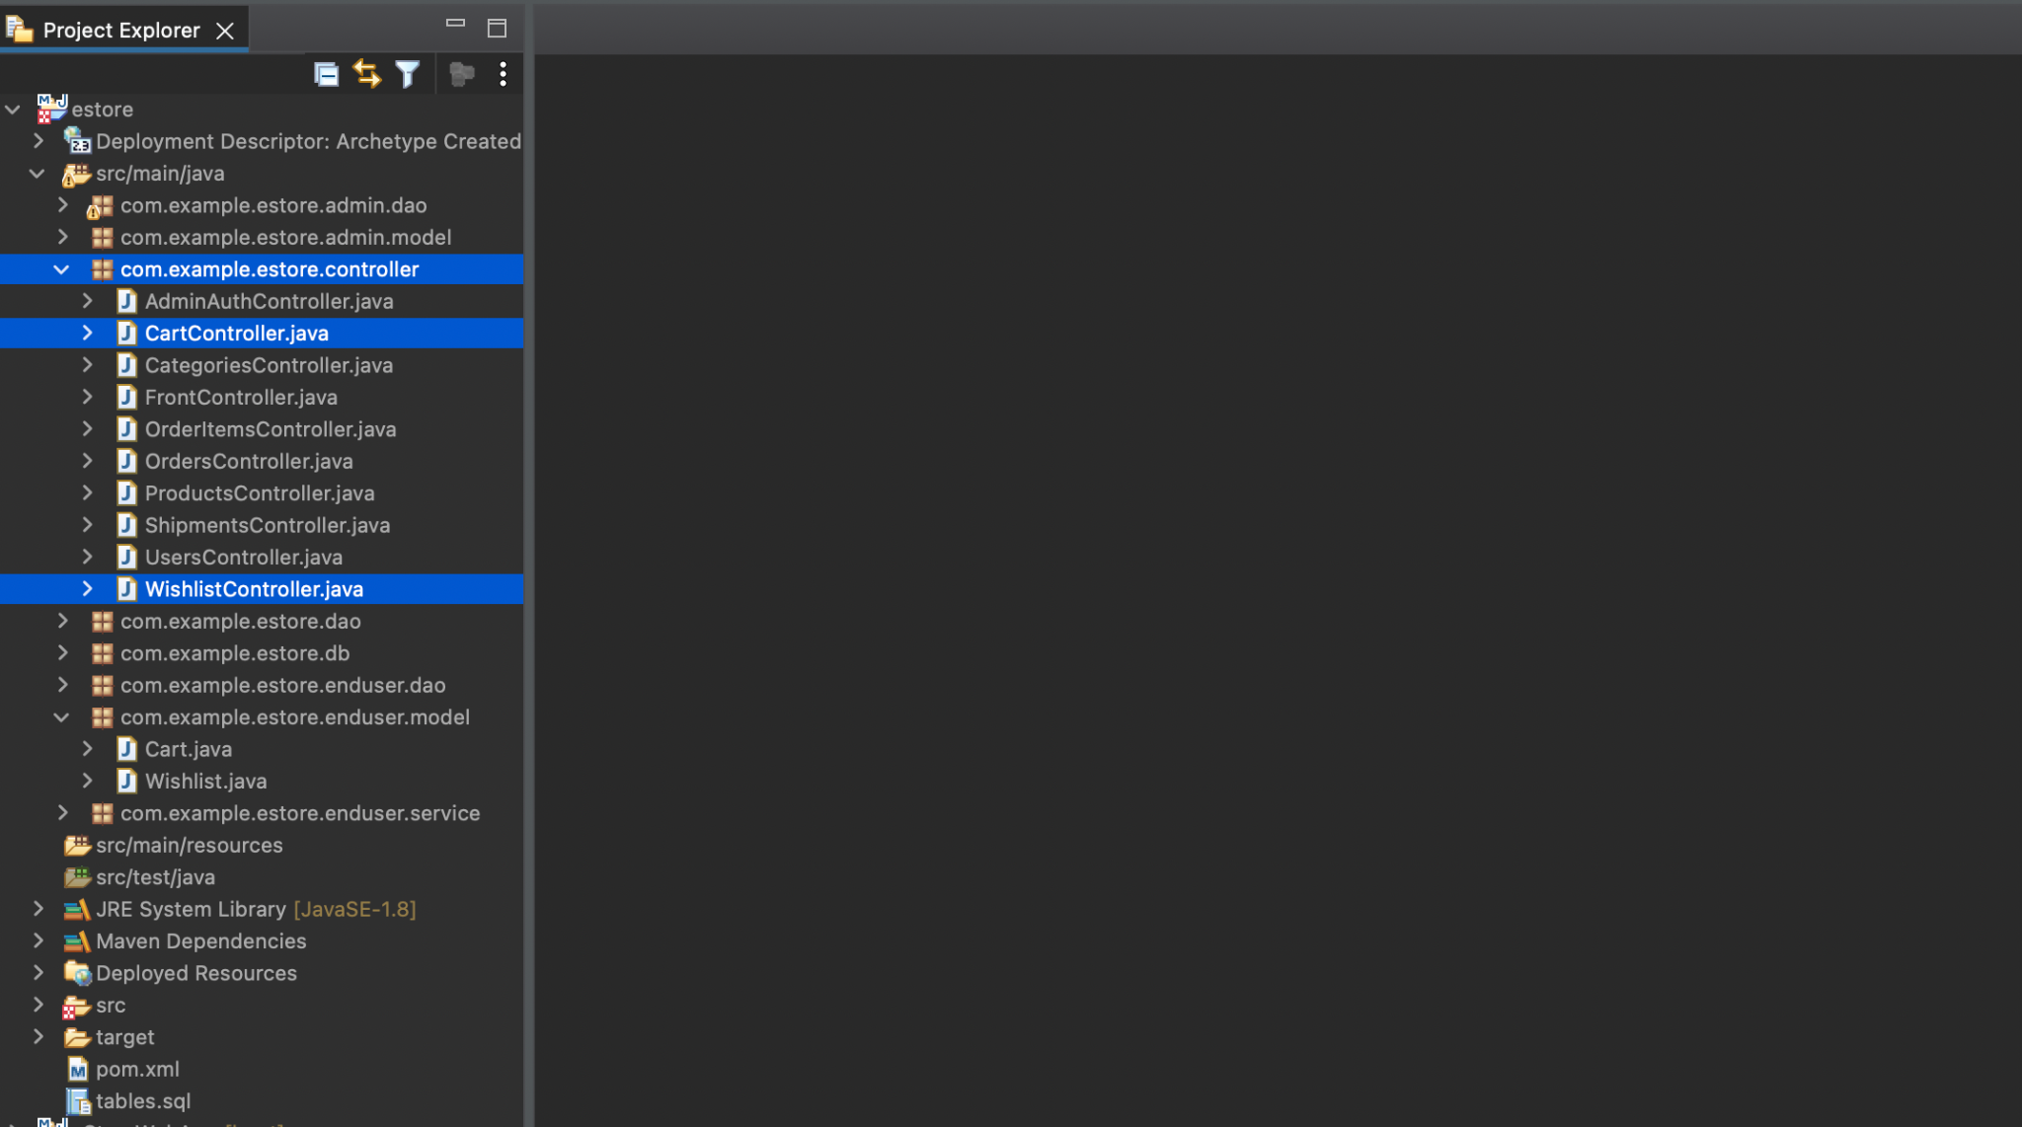
Create Servlets as Controllers Implementing DAO for End User
Create various servlets as controller, which will process request and response using DAO to perform CRUD operations for end user backend.
Notes:
Now we will create various Servlets as controller which will process request and response using DAO to perform CRUD Operations for End User Backend

Slide 64
Create Servlets as Controllers Implementing DAO for End User
CartController.java : Servlet for HTTP Request Response for Shopping Cart of the User, which will manage CRUD Operations using DAO
Notes:
Overview of Servlets as Controller which will be used:
CartController.java
Servlet for HTTP Request Response for Shopping Cart of the User, which will manage CRUD Operations using DAO

Slide 65
Create Servlets as Controllers Implementing DAO for End User
WishlistController.java : Servlet for HTTP Request Response for Wishlisted Products by User, which will manage CRUD Operations using DAO
Notes:
WishlistController.java
Servlet for HTTP Request Response for Wishlisted Products by User, which will manage CRUD Operations using DAO

Slide 66
Create a Cart Servlet

Slide 67
CartController.java: Implementation of Servlet for Cart
To perform CRUD Operations for the Shopping Cart, use Cart Table and Cart Model, CartDAO with DB operations implemented already.
package com.example.estore.controller;
import java.io.IOException;
import javax.servlet.ServletException;
import javax.servlet.http.HttpServlet;
import javax.servlet.http.HttpServletRequest;
import javax.servlet.http.HttpServletResponse;
public class CartController extends HttpServlet {
private static final long serialVersionUID = 1L;
Notes:
Let us now implement CartController Servlet.
In order to perform CRUD Operations for the Shopping Cart and details of the Cart we got Cart Table and Cart Model, CartDAO with DB operations, implemented already

Slide 68
CartController.java: Implementation of Servlet for Cart
doGet - Gets the details of the user’s cart based on the user id
protected void doGet(HttpServletRequest request, HttpServletResponse response) throws ServletException, IOException {
// TODO Auto-generated method stub
}
Notes:
We will implement doGet, doPost, doPut, doDelete methods in our Servlet to perform CRUD operations using DAO and Models internally to:
doGet - get the cart object of a User based on the user id i.e. fetch all the cart details

Slide 69
CartController.java: Implementation of Servlet for Cart
doPost - Adds a new Product Object in the Cart in the database by taking the details in HttpRequest and sending HttpResponse as JSON for success/failure cases.
protected void doPost(HttpServletRequest request, HttpServletResponse response) throws ServletException, IOException {
// TODO Auto-generated method stub
}
Notes:
doPost - Add a new Product Object in the Cart in the database by taking the details in HttpRequest and sending HttpResponse as JSON for success/failure cases

Slide 70
CartController.java: Implementation of Servlet for Cart
doPut - Updates an existing Cart in the database by taking the details of Cart for a User in HttpRequest and sending HttpResponse as JSON for success/failure cases.
protected void doPut(HttpServletRequest request, HttpServletResponse response) throws ServletException, IOException {
// TODO Auto-generated method stub
}
Notes:
doPut - Update an existing Cart in the database by taking the details of Cart for a User in HttpRequest and sending HttpResponse as JSON for success/failure cases

Slide 71
CartController.java: Implementation of Servlet for Cart
doDelete - Deletes an existing Cart in the database by taking the Cart id of Cart for a User in HttpRequest and sending HttpResponse as JSON for success/failure cases.
protected void doDelete(HttpServletRequest request, HttpServletResponse response) throws ServletException, IOException {
// TODO Auto-generated method stub
}
}
Notes:
doDelete - Delete an existing Cart in the database by taking the Cart id of Cart for a User in HttpRequest and sending HttpResponse as JSON for success/failure cases

Slide 72
Create a Wishlist Servlet

Slide 73
WishlistController.java: Implementation of Servlet for Wishlist
To perform CRUD Operations for the Wishlist, use Wishlist Table and Wishlist Model, WishlistDAO with DB operations implemented already.
package com.example.estore.controller;
import java.io.IOException;
import javax.servlet.ServletException;
import javax.servlet.http.HttpServlet;
import javax.servlet.http.HttpServletRequest;
import javax.servlet.http.HttpServletResponse;
public class WishlistController extends HttpServlet {
private static final long serialVersionUID = 1L;
Notes:
Let us now implement WishlistController Servlet.
In order to perform CRUD Operations for the Wishlist and details of the Wishlist we got Wishlist Table and Wishlist Model, WishlistDAO with DB operations, implemented already

Slide 74
WishlistController.java: Implementation of Servlet for Wishlist
doGet - Gets a single Wishlist based on Wishlist id or a list of Wishlist objects.
protected void doGet(HttpServletRequest request, HttpServletResponse response) throws ServletException, IOException {
// TODO Auto-generated method stub
}
Notes:
We will implement doGet, doPost, doPut, doDelete methods in our Servlet to perform CRUD operations using DAO and Models internally to:
doGet - get a single Wishlist based on Wishlist id or a list of Wishlist objects i.e. fetch all the Wishlist

Slide 75
WishlistController.java: Implementation of Servlet for Wishlist
doPost - Adds a new Wishlist in the database by taking the details of Wishlist in HttpRequest and sending HttpResponse as JSON for success/failure cases.
protected void doPost(HttpServletRequest request, HttpServletResponse response) throws ServletException, IOException {
// TODO Auto-generated method stub
}
Notes:
doPost - Add a new Wishlist in the database by taking the details of Wishlist in HttpRequest and sending HttpResponse as JSON for success/failure cases

Slide 76
WishlistController.java: Implementation of Servlet for Wishlist
doPut - Updates an existing Wishlist in the database by taking the details of Wishlist in HttpRequest and sending HttpResponse as JSON for success/failure cases.
protected void doPut(HttpServletRequest request, HttpServletResponse response) throws ServletException, IOException {
// TODO Auto-generated method stub
}
Notes:
doPut - Update an existing Wishlist in the database by taking the details of Wishlist in HttpRequest and sending HttpResponse as JSON for success/failure cases

Slide 77
WishlistController.java: Implementation of Servlet for Wishlist
doDelete - Deletes an existing Wishlist in the database by taking the Wishlist id of Wishlist in HttpRequest and sending HttpResponse as JSON for success/failure cases.
protected void doDelete(HttpServletRequest request, HttpServletResponse response) throws ServletException, IOException {
// TODO Auto-generated method stub
}
}
Notes:
doDelete - Delete an existing Wishlist in the database by taking the Wishlist id of Wishlist in HttpRequest and sending HttpResponse as JSON for success/failure cases

Slide 78
Write Test Cases for Backend using JUnit

Slide 79
Unit Testing with JUnit

Slide 80
Add JUnit Dependency for Unit Testing
In the Maven project, open the pom.xml file and add the dependency for JUnit Library. Find it on mvnrepository.com.
<dependency>
<groupId>org.junit.jupiter</groupId>
<artifactId>junit-jupiter-engine</artifactId>
<version>5.8.1</version>
<scope>test</scope>
</dependency>
The library uses JUnit Jupiter APIs for the test cases to be implemented.
Notes:
In your maven project, open the pom.xml file and add the dependency for junit Library. You can find it on mvnrepository.com
The library uses JUnit Jupiter APIs for the test cases to be implemented

Slide 81
Write various Unit Test Cases
Create a file in the test package by the name of AppTest.java and write various test cases for the scenarios.
public class AppTest {
@Test
public void testAdminLogin() {
AdminsDAO dao = new AdminsDAO();
Admins admin = new Admins();
admin.setEmail("test-admin@example.com");
admin.setPassword("test-password");
dao.login(admin);
assertTrue("Login Issue", !admin.getFullName().isEmpty());
}
Notes:
Now, create a file in the test package by the name of AppTest.java and write various test cases for the scenarios.

Slide 82
Write various Unit Test Cases
Sample test cases to test the login flow are implemented already.
@Test
public void testUserLogin() {
UsersDAO dao = new UsersDAO();
Users user = new Users();
user.setEmail("test-user@example.com");
user.setPassword("test-password");
dao.login(user);
assertTrue("Login Issue", !user.getFullName().isEmpty());
}
}
Notes:
Example Test Cases to test the login flow, are implemented already.

Slide 83
Various servlets as controllers are created to process request and response using DAO to perform CRUD operations for the frontend admin and backend end user.
doGet, doPost, doPut, and doDelete methods are implemented in servlets to perform CRUD operations using DAO.
CRUD operations are implemented for various models in accordance with the requests in servlets.
Working with JSON Response is tested using Google GSON.

Slide 85
Which of the following HTTP Method is overridden in Servlet to update the data?
01
doGet
doPost
doPut
doUpdate

Slide 86
Which of the following HTTP Method is overridden in Servlet to update the data?
01
doGet
doPost
doPut
doUpdate
C
In order to update record, use doPut HTTP method in Servlet as a handler.

Slide 87
Where is servlet mapping declared?
02
pom.xml
index.html
web.xml
no need to declare

Slide 88
Where is servlet mapping declared?
02
pom.xml
index.html
web.xml
no need to declare
C
web.xml is the deployment descriptor that contains the Servlet Mapping.

Slide 89
Which method on HttpRequest is used to read data from client?
03
getParameter
getData
getAttribute
getPostParameter

Slide 90
Which method on HttpRequest is used to read data from client?
03
getParameter
getData
getAttribute
getPostParameter
A
We use request.getParameter(paramName) to read data in the Client Request over HTTP in Servlet.

Slide 91
In order to send back the response from Servlet, which content type is set?
04
text/json
html/json
application/html
application/json

Slide 92
In order to send back the response from Servlet, which content type is set?
04
text/json
html/json
application/html
application/json
D
In order to set JSON response type, you need to execute response.setContentType("application/json").

Slide 93
In order to create a Servlet in Java with doPost and doGet methods, which class is
extended?
05
HttpServlet
Servlet
GenericServlet
Controller

Slide 94
In order to create a Servlet in Java with doPost and doGet methods, which class is
extended?
05
HttpServlet
Servlet
GenericServlet
Controller
A
HttpServlet is extended to override the http methods in the Child Servlet Class.

Slide 95
Before the Next Class
Since you have successfully completed this session. Before the next discussion, you should go through:
Spring Boot
Webservices
Microservices

Slide 96
What’s Next?
We have finished our Classes and Design Pattern for the Backend Project wrt End Usermodule. In our next live session, we will :
Explore how to create Spring Boot Project
See how to work with microservices
Learn to use various annotations in Spring Boot
Perform CRUD Operations with DB using CrudRepository in Spring Boot

